Slide 1
Welcome to the Shared Governance Workshop
Deal Makers & Deal Breakers
Facilitated by the Agility Implementation Team
January 9, 2019
>

Slide 2
What is shared governance?

Slide 3
Work Thus Far
Reviewed a number of articles on shared governance
Drafted a shared governance statement and revised it based on solicited feedback
Attempted to map AWC’s current structure
Reviewed shared governance structures from ten institutions
Catalogued the elements common to the various models

Slide 4
What is the purpose of this workshop?
Present the two most common structural options for the central decision-making bodies
Get detailed feedback on the concrete pros and cons of the two options
Begin to discuss the subject of committee creation
The Agility team will then begin to draft a model based on this feedback

Slide 5
AWC GOVERNANCE MODEL

Slide 6
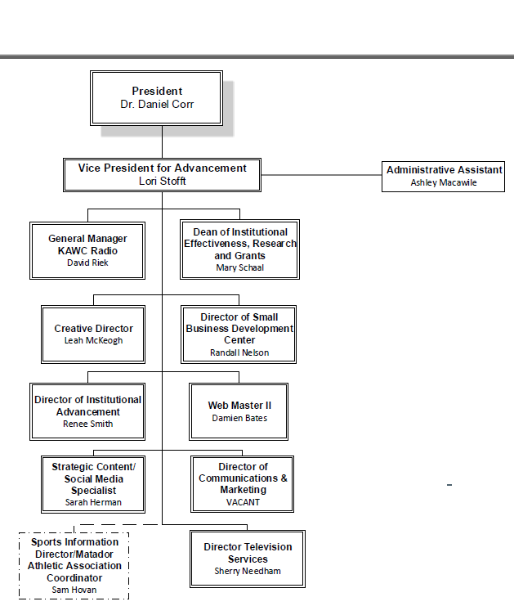
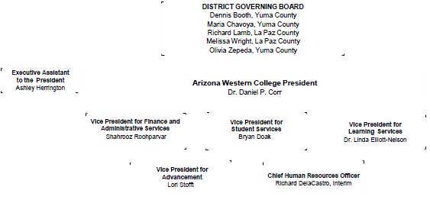
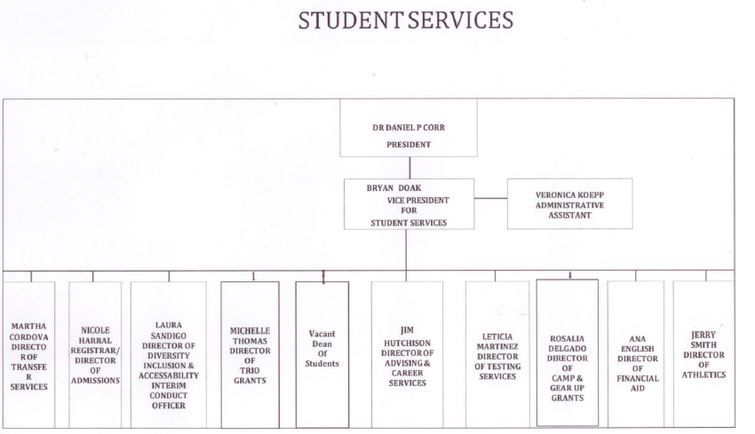
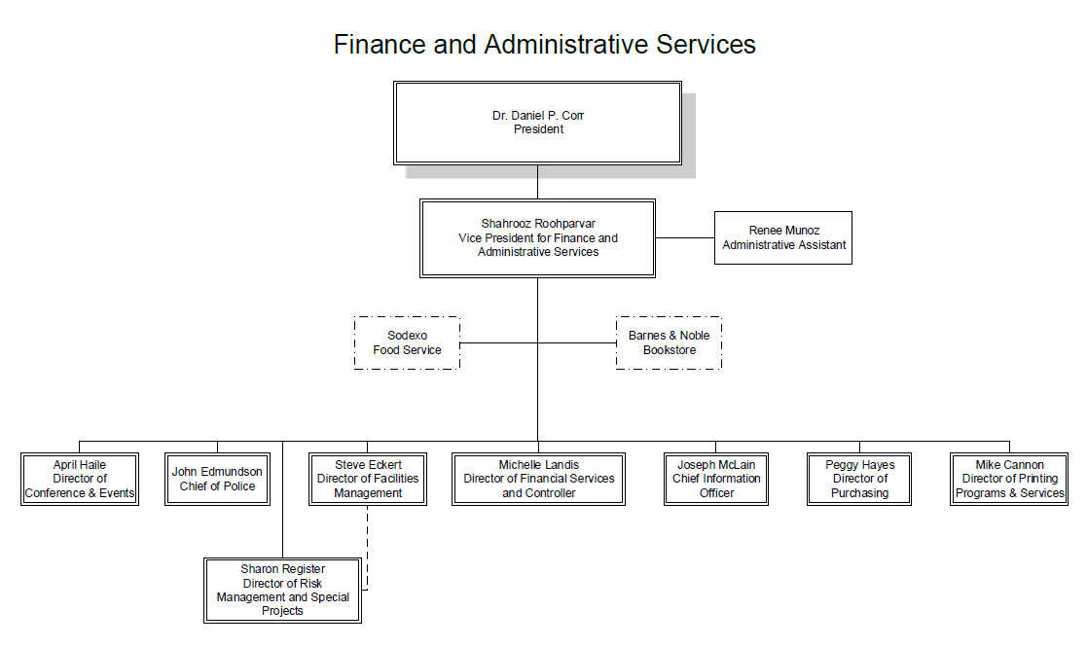
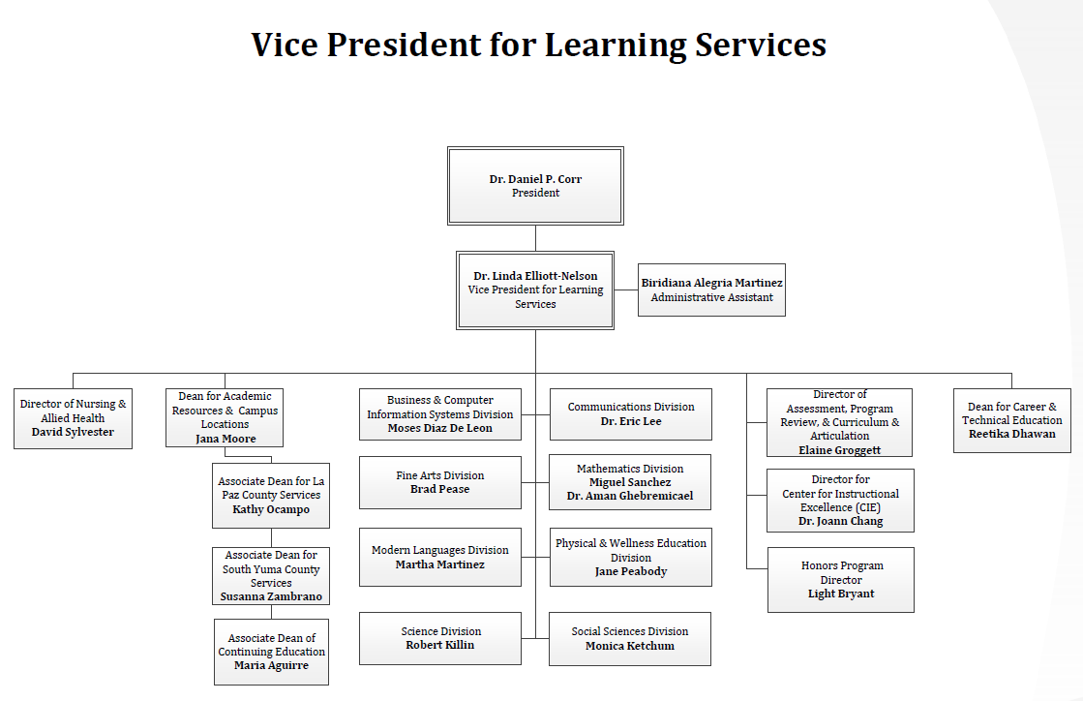
AWC ORGANIZATIONAL CHARTS
Advancement
Finance & Administrative Services
Student Services
Learning Services

Slide 7
67+ Committee/Workgroup list

Slide 8
Pasadena Model

Slide 9
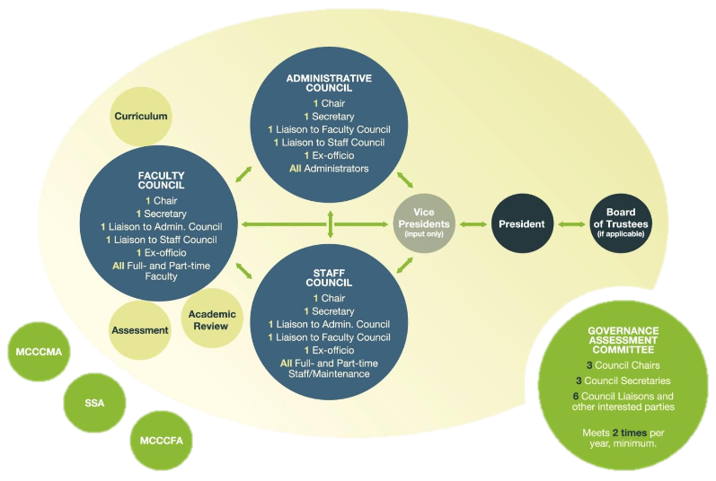
Monroe
Community College Model

Slide 10
REFLECTIONS
Questions on the two models?

Slide 11
Your Turn
What are your deal makers and deal breakers from the
Pasadena Model?
(15 minutes)

Slide 12
Your Turn
What are your deal makers and deal breakers from the
Monroe Model?
(15 minutes)

Slide 13
DEAL
MAKERS
DEAL
BREAKERS
&

Slide 14
AWC COMMITTEES

Slide 15
NEXT STEPS

